Slide 1


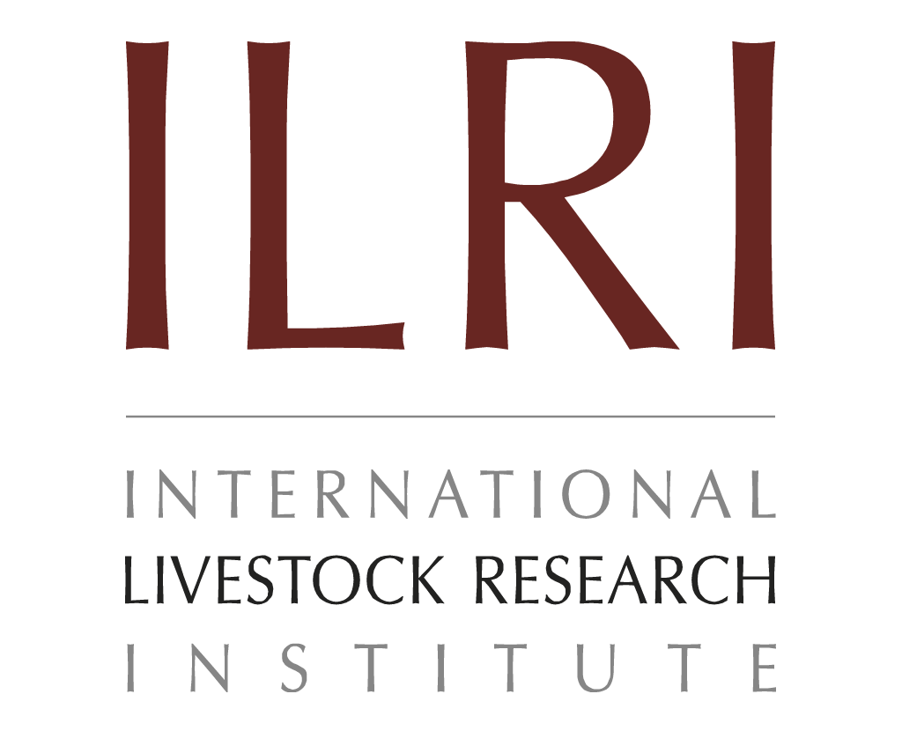

Estimating feed ME concentration and livestock ME requirements
Presentation for Resilient African feed and fodder systems project— 2nd national feed inventory landscape and capacity building workshop
October 31, 2024
John Mutua

Slide 2
Feed ME concentration
ME concentration of feeds was calculated using species-specific and regional estimates from literature and databases
Approximations assumed a linear relationship between digestible energy (DE) and ME, predicted by NDF and CP
IVDMD as percent of total DM was estimated using laboratory methods (Tilley and Terry, 1963)
DE was calculated based on NRC (2001), establishing a relationship between OM, IVOMD, and DE
Where SSA feed database was used, IVDMD was used as a proxy for IVOMD, and in absence of OM estimates, it was assumed to be 90% of DM
Location-specific ME estimates were prioritized; where unavailable, estimates from other regions were used

Slide 3
Livestock ME energy requirements
ME requirements for ruminant livestock were estimated using CSIRO (2008) equations
ME requirements were estimated for maintenance, growth, locomotion, gestation, and lactation for dry and wet seasons
Inputs included population estimates, herd structure, starting liveweight, growth rates, pregnancy rates, milk yield, locomotion needs, and draught power usage by species and animal class
Herds and flocks were disaggregated into adult and young for sheep and goats, and into bulls, steers, cows, heifers and calves for cattle
Initial estimates of requirements were representative of circa 2015, requirements were extrapolated based on annual population statistics for cattle, sheep and goats

Slide 4
Thank you

